Slide 1

《HTML Basics》
周思吉（Zhou SiJi） 2024年12月

Slide 2

one
HTML Tables
Part

Slide 3

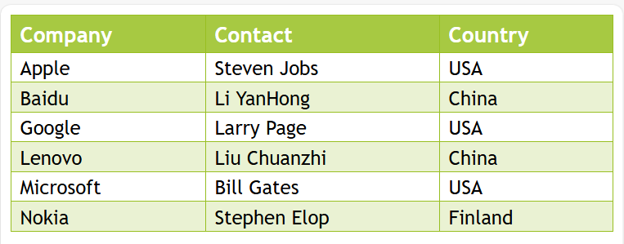
1：HTML Tables
HTML tables allow web developers to arrange data into rows and columns.

Slide 4
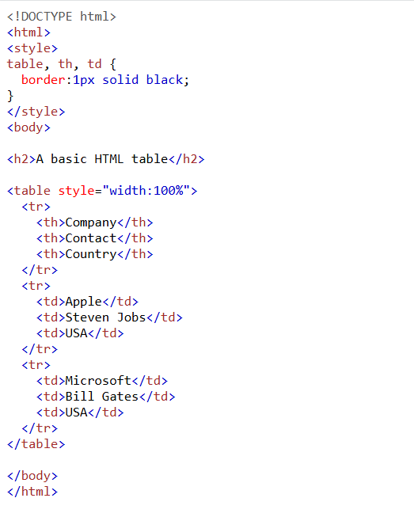
HTML Tables
Define an HTML Table
A table in HTML consists of table cells inside rows and columns.

Slide 5
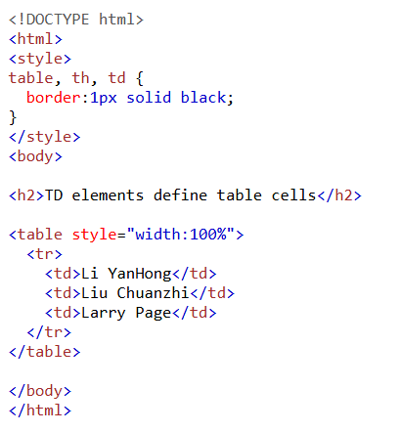
HTML Tables
Table Cells
Each table cell is defined by a <td> and a </td> tag.
td stands for table data.
Everything between <td> and </td> are the content of the table cell.
Note: A table cell can contain all sorts of HTML elements: text, images, lists, links, other tables, etc.

Slide 6
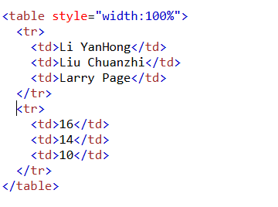
HTML Tables
Table Rows
Each table row starts with a <tr> and ends with a </tr> tag.
tr stands for table row.
You can have as many rows as you like in a table; just make sure that the number of cells are the same in each row.
Note: There are times when a row can have less or more cells than another. You will learn about that in a later

Slide 7
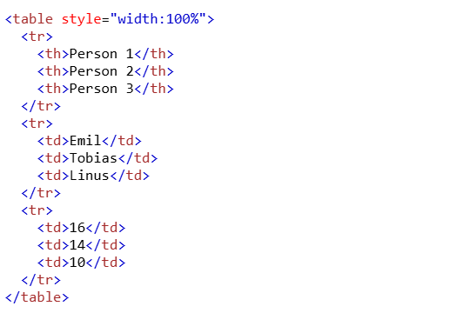
HTML Tables
Table Headers
Sometimes you want your cells to be table header cells. In those cases use the <th> tag instead of the <td> tag:
th stands for table header.
Example
Let the first row be table header cells:
By default, the text in <th> elements are bold and centered, but you can change that with CSS.

Slide 8
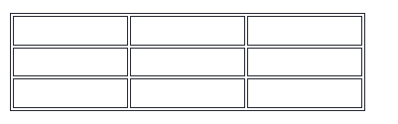
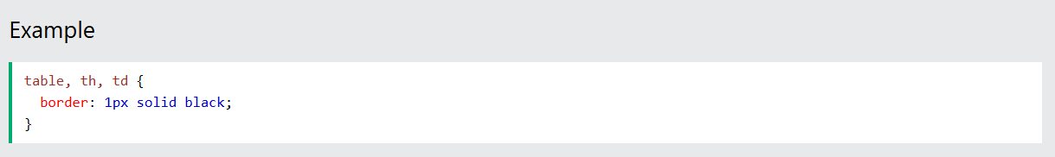
HTML Tables-HTML Table Borders
HTML Table Borders
HTML tables can have borders of different styles and shapes.
How To Add a Border
To add a border, use the CSS border property on table, th, and td elements:

Slide 9
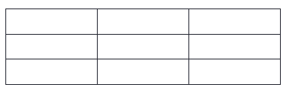
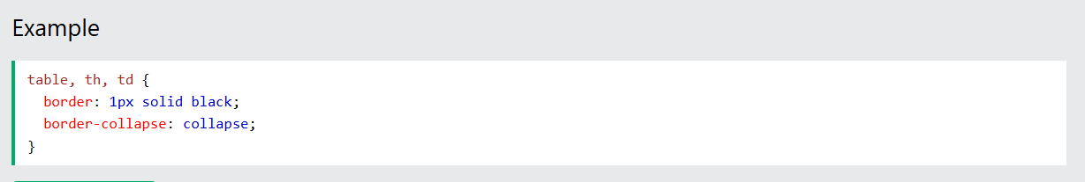
HTML Tables-HTML Table Borders
Collapsed Table Borders
To avoid having double borders like in the example above, set the CSS border-collapse property to collapse.
This will make the borders collapse into a single border:

Slide 10

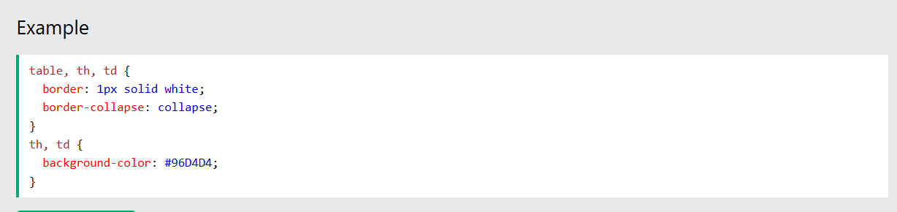
HTML Tables-HTML Table Borders
Style Table Borders
If you set a background color of each cell, and give the border a white color (the same as the document background), you get the impression of an invisible border:

Slide 11
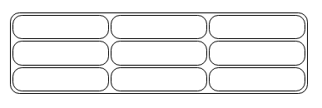
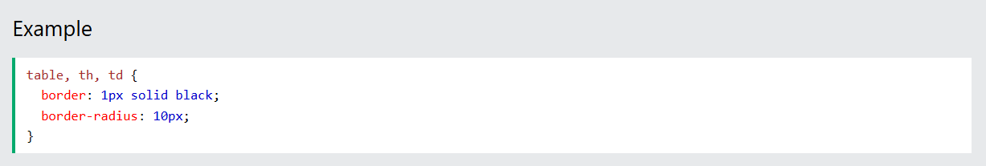
HTML Tables-HTML Table Borders
Round Table Borders
With the border-radius property, the borders get rounded corners:

Slide 12
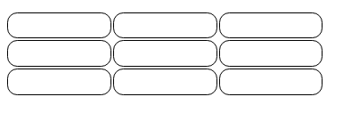
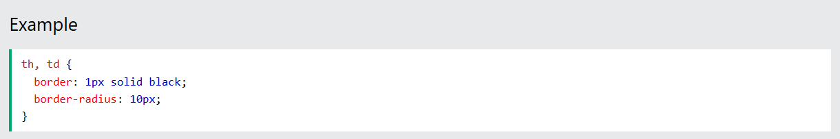
HTML Tables-HTML Table Borders
Skip the border around the table by leaving out table from the css selector:

Slide 13
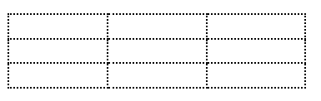
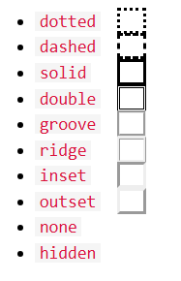
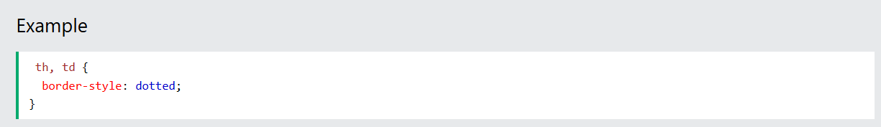
HTML Tables-HTML Table Borders
Dotted Table Borders
With the border-style property, you can set the appearance of the border.
The following values are allowed:

Slide 14
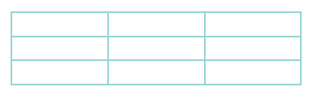
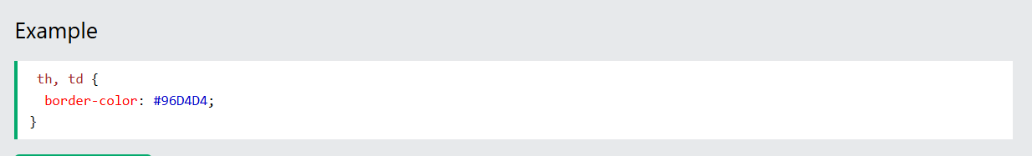
HTML Tables-HTML Table Borders
Border Color
With the border-color property, you can set the color of the border.

Slide 15
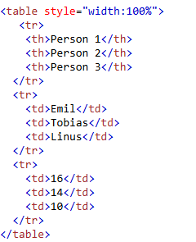
HTML Tables-HTML Table Sizes
HTML Table Sizes
HTML tables can have different sizes for each column, row or the entire table.
Use the style attribute with the width or height properties to specify the size of a table, row or column.
HTML Table Width
To set the width of a table, add the style attribute to the <table> element:
Note: Using a percentage as the size unit for a width means how wide will this element be compared to its parent element, which in this case is the <body> element.

Slide 16

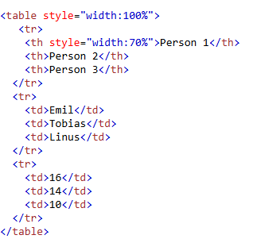
HTML Tables-HTML Table Sizes
HTML Table Column Width
To set the size of a specific column, add the style attribute on a <th> or <td> element:
Example
Set the width of the first column to 70%:

Slide 17
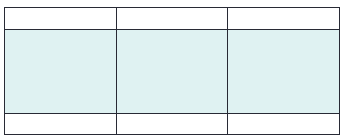
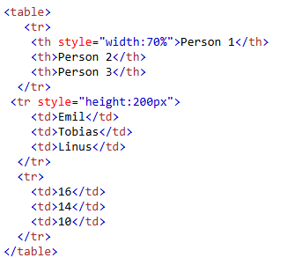
HTML Tables-HTML Table Sizes
HTML Table Row Height
To set the height of a specific row, add the style attribute on a table row element:
Example
Set the height of the second row to 200 pixels:

Slide 18
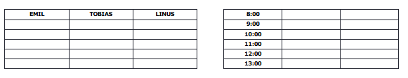
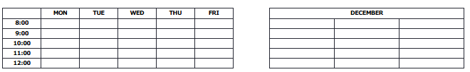
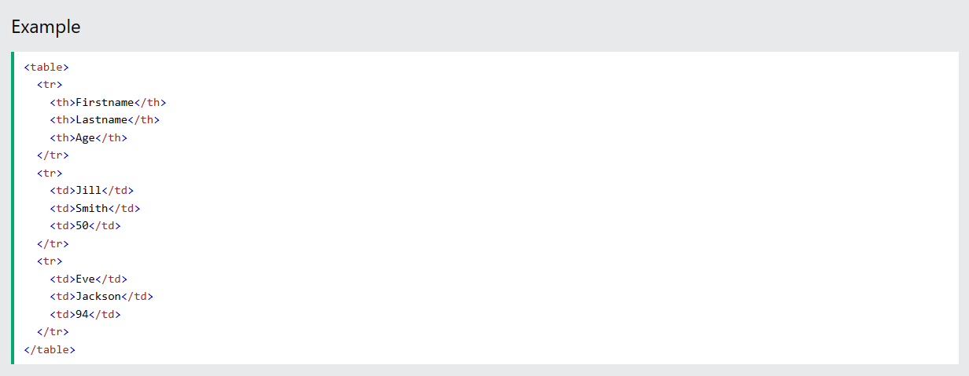
HTML Tables-Headers
HTML Table Headers
HTML tables can have headers for each column or row, or for many columns/rows.
Table headers are defined with th elements. Each th element represents a table cell.

Slide 19
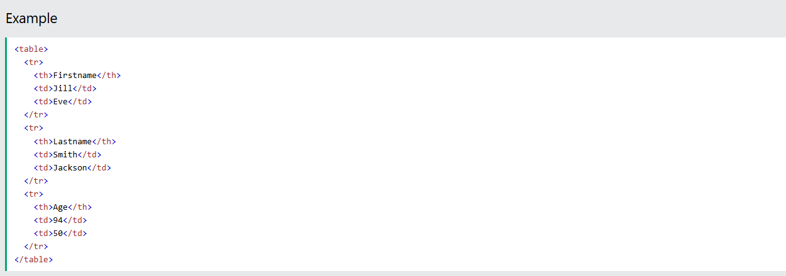
HTML Tables-Headers
Vertical Table Headers
To use the first column as table headers, define the first cell in each row as a <th> element:

Slide 20
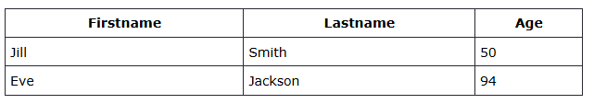
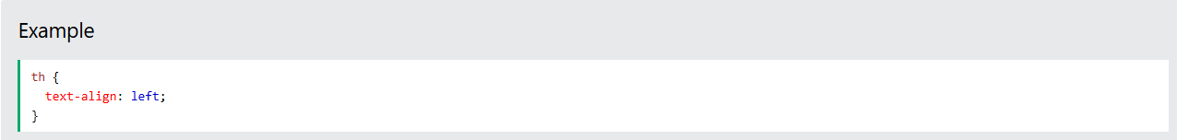
HTML Tables-Headers
Align Table Headers
By default, table headers are bold and centered:
To left-align the table headers, use the CSS text-align property:

Slide 21
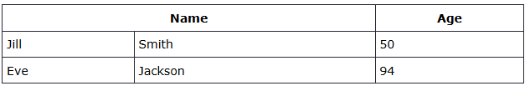
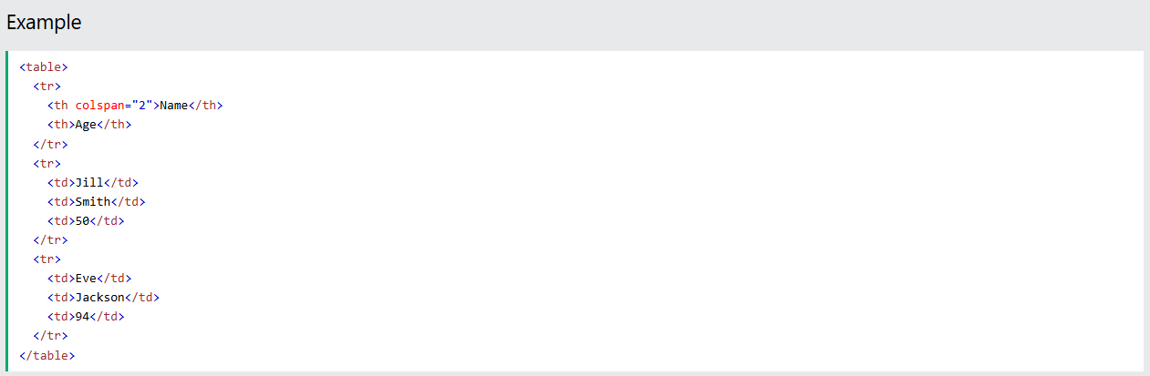
HTML Tables-Headers
Header for Multiple Columns
You can have a header that spans over two or more columns.
To do this, use the colspan attribute on the <th> element:

Slide 22
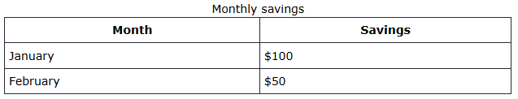
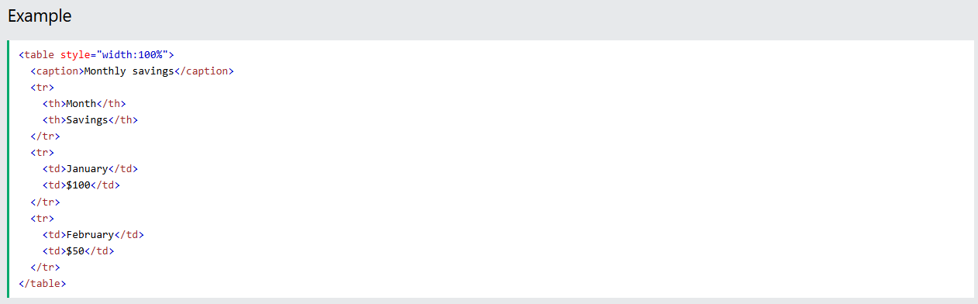
HTML Tables-Headers
Table Caption
You can add a caption that serves as a heading for the entire table.
To add a caption to a table, use the <caption> tag:
Note: The <caption> tag should be inserted immediately after the <table> tag.

Slide 23
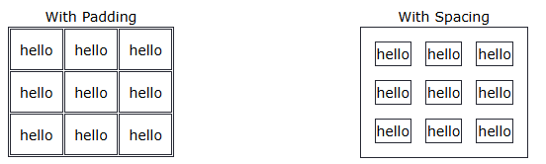
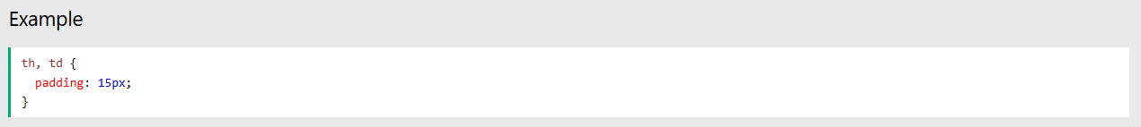
HTML Tables-Padding & Spacing
HTML Table Padding & Spacing
HTML tables can adjust the padding inside the cells, and also the space between the cells.
HTML Table - Cell Padding
Cell padding is the space between the cell edges and the cell content.
By default the padding is set to 0.
To add padding on table cells, use the CSS padding property:

Slide 24
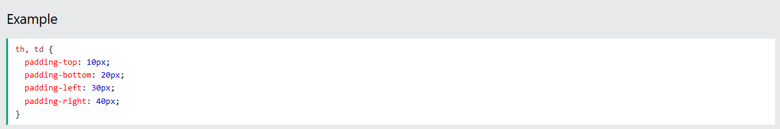
HTML Tables-Padding & Spacing
To add padding only above the content, use the padding-top property.
And the others sides with the padding-bottom, padding-left, and padding-right properties:

Slide 25
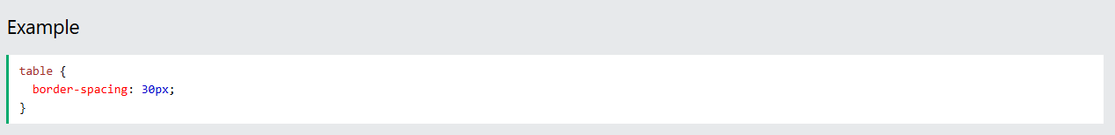
HTML Tables-Padding & Spacing
HTML Table - Cell Spacing
Cell spacing is the space between each cell.
By default the space is set to 2 pixels.
To change the space between table cells, use the CSS border-spacing property on the table element:

Slide 26
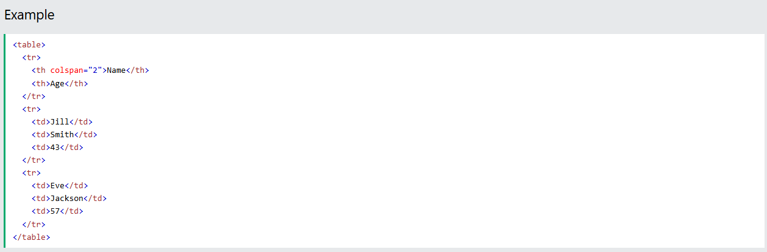
HTML Table Colspan & Rowspan
HTML Table Colspan & Rowspan
HTML tables can have cells that span over multiple rows and/or columns.
HTML Table - Colspan
To make a cell span over multiple columns, use the colspan attribute:
Note: The value of the colspan attribute represents the number of columns to span.

Slide 27
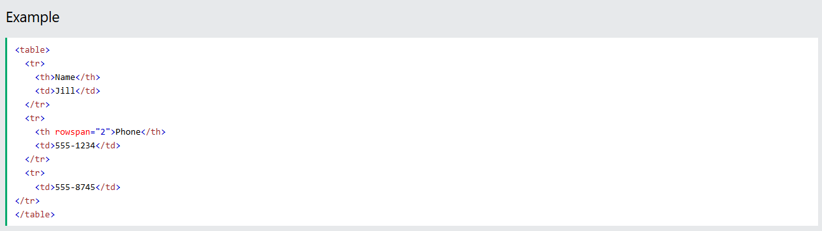
HTML Table Colspan & Rowspan
HTML Table - Rowspan
To make a cell span over multiple rows, use the rowspan attribute:
Note: The value of the rowspan attribute represents the number of rows to span.

Slide 28
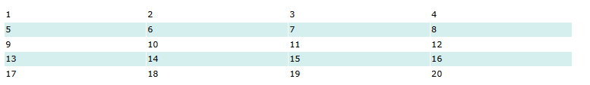
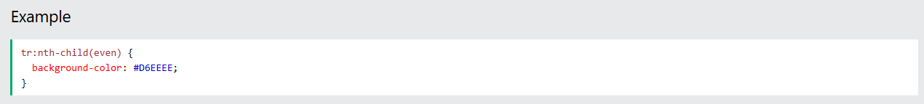
HTML Table Styling
HTML Table Styling
Use CSS to make your tables look better.
HTML Table - Zebra Stripes
If you add a background color on every other table row, you will get a nice zebra stripes effect.
To style every other table row element, use the :nth-child(even) selector like this:
Note: If you use (odd) instead of (even), the styling will occur on row 1,3,5 etc. instead of 2,4,6 etc.

Slide 29
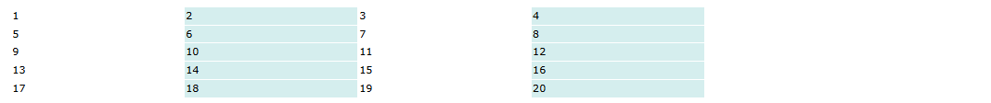
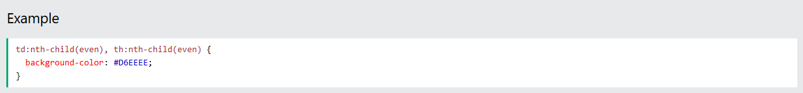
HTML Table Styling
HTML Table - Vertical Zebra Stripes
To make vertical zebra stripes, style every other column, instead of every other row.
Note: Put the :nth-child() selector on both th and td elements if you want to have the styling on both headers and regular table cells.

Slide 30
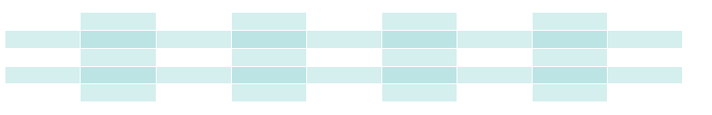
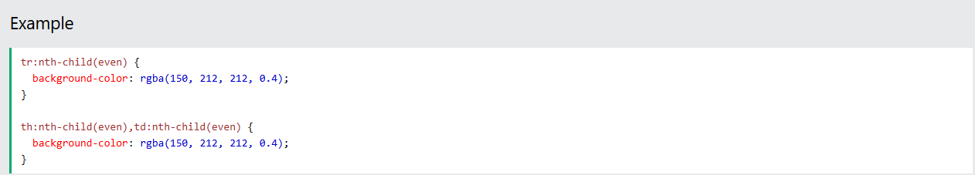
HTML Table Styling
Combine Vertical and Horizontal Zebra Stripes
You can combine the styling from the two examples above and you will have stripes on every other row and every other column.
If you use a transparent color you will get an overlapping effect.
Use an rgba() color to specify the transparency of the color:

Slide 31
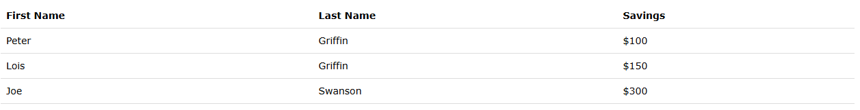
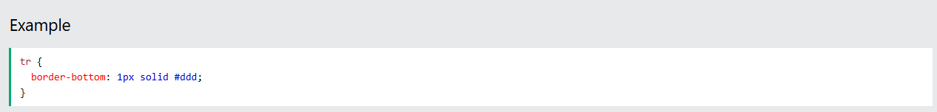
HTML Table Styling
Horizontal Dividers
If you specify borders only at the bottom of each table row, you will have a table with horizontal dividers.
Add the border-bottom property to all tr elements to get horizontal dividers:

Slide 32
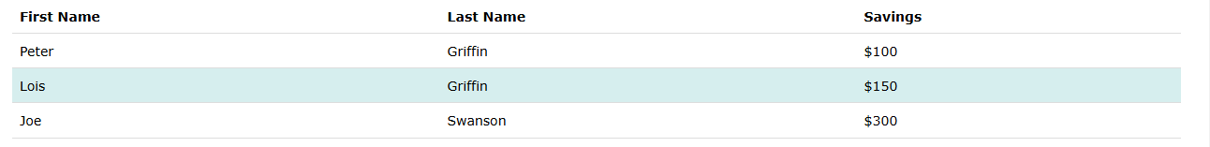
HTML Table Styling
Hoverable Table
Use the :hover selector on tr to highlight table rows on mouse over:

Slide 33
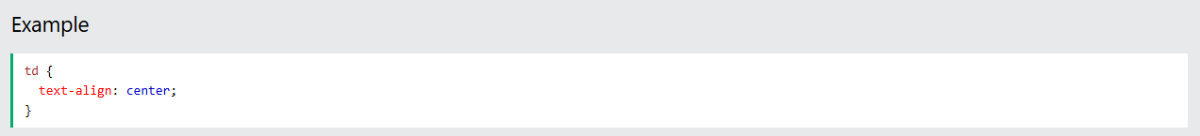
CSS Table Alignment
CSS Table Alignment
Horizontal Alignment
The text-align property sets the horizontal alignment (like left, right, or center) of the content in <th> or <td>.
By default, the content of <th> elements are center-aligned and the content of <td> elements are left-aligned.
To center-align the content of <td> elements as well, use text-align: center:

Slide 34
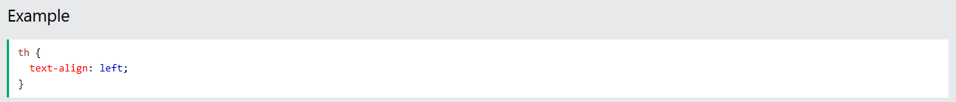
CSS Table Alignment
To left-align the content, force the alignment of <th> elements to be left-aligned, with the text-align: left property:

Slide 35

CSS Table Alignment
To left-align the content, force the alignment of <th> elements to be left-aligned, with the text-align: left property:

Slide 36


CSS Table Alignment
Vertical Alignment
The vertical-align property sets the vertical alignment (like top, bottom, or middle) of the content in <th> or <td>.
By default, the vertical alignment of the content in a table is middle (for both <th> and <td> elements).
The following example sets the vertical text alignment to bottom for <td> elements:

Slide 37


CSS Table Alignment
Responsive Table
A responsive table will display a horizontal scroll bar if the screen is too small to display the full content:
Add a container element (like <div>) with overflow-x:auto around the <table> element to make it responsive:

Slide 38
exercise
Complete the exercise

Slide 39

感谢聆听！

